Slide 1
Creating and Using Packages

Slide 2
What is it?
A package is a collection of related types (classes, interfaces, enums and annotations) providing access protection
They define a hierarchical namespace, so that classes with the same name will not clash with each
java.awt.List vs java.util.List
A package name matches the directory name where the source and class files are stored

Slide 3
Why Use Packages?
There are two main reasons for using packages:
To avoid naming conflicts
When you develop reusable classes to be shared by other programmers, naming conflicts may occur; to prevent this, put your classes into packages so that they can be referenced through package names
To protect classes
Packages provide protection so that the protected members of the classes are accessible to the classes in the same package, but not to the external classes

Slide 4
Importing Classes
within a package classes can refer to each other directly
to get access to classes from another package you need to
describe the full name of the class from another package
java.util.ArrayList list = new java.util.ArrayList();
or import the specific class from that package
import java.util.ArrayList;
ArrayList list = new ArrayList();
or import all classes from that package
import java.util.*;
ArrayList list = new ArrayList();
all import statements must appear after the package declaration, but before the class or interface declarations

Slide 5
Package-Naming Conventions
Packages are hierarchical, and you can have packages within packages
For example, java.lang.Math indicates that Math is a class in the package lang and that lang is a package in the package java
Levels of nesting can be used to ensure the uniqueness of package names
Choosing a unique name is important because your package may be used by other programs
Because internet domain names are unique, It is recommended that you use your Internet domain name in reverse order as a package prefix. ex. ca.bcit
By convention, package names are all in lowercase

Slide 6

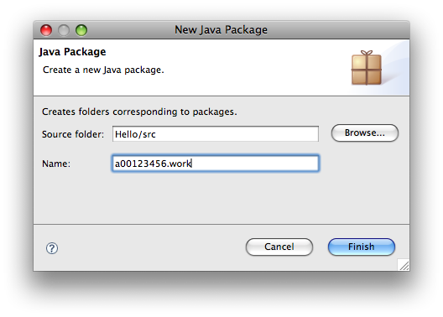
> Adding packages in eclipse
Right-click on “src” in the Package Explorer
Select “New”
Select “Java Package”
Enter <student#>.work1
remember! package names are all lowercase characters

Slide 7
Putting Classes into Packages
Every class in Java belongs to a package
The class is added to the package when it is compiled
The Hello class was placed in the default package originally
To put a class in a specific package, you need to add the following line as the first non-comment and non-blank statement in the program:
package <package name>;
e.g. package a00123456.work1;

Slide 8
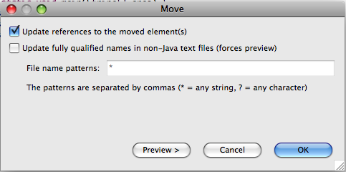
Refactoring in eclipse
To move the Main class to the newly created package, just drag and drop

Slide 9
> Fix Hello
Move “Hello” to the <student#>.work1 folder
Select Hello.java and drag-and-drop it onto <student#>.work1
In the Move dialog, select OK
Confirm everything still works by running your project

Slide 10
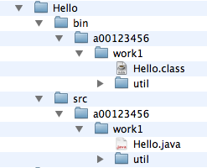
Package Directories
Java expects one-to-one mapping of the package name and the file system directory structure.
For the package named a00123456.work1, you must create a directory, as shown in the figure
A package is actually a directory that contains the bytecode of the classes.
a00123456.work1
The a00123456 directory does not have to be the root directory. In order for Java to know where your package is in the file system, you must modify the classpath so that it points to the directory in which your package resides

Slide 11
Putting Classes into Packages
This example creates a class named Format and places it in the package a00123456.work1.util
The Format class contains the format(number, numOfDecimalDigits) method that returns a new number with the specified number of digits after the decimal point
For example, format(10.3422345, 2) returns 10.34, and format(-0.343434, 3) returns –0.343.

Slide 12
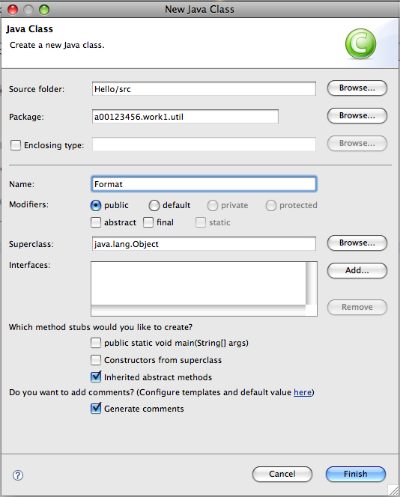
> Create a util package
Create a new package named <student#>.work1.util and a new class named Format

Slide 13
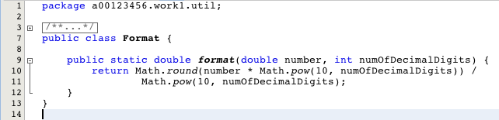
> Create the Format class
public class Format {
public static double format(double number, int numOfDecimalDigits) {
return Math.round(number * Math.pow(10, numOfDecimalDigits)) /
Math.pow(10, numOfDecimalDigits);
} }

Slide 14
Using Classes from Packages
There are two ways to use classes from a package
One way is to use the fully qualified name of the class
For example, the fully qualified name for Arrays is java.uril.Arrays.
For Format in the preceding example, it is <student#>.util.Format

Slide 15
Using Classes from Packages
The other way is to use the import statement. For example, to import all the classes in the javax.util package, you can use
import javax.util.*;
An import that uses a * is called an import on demand declaration. You can also import a specific class.
For example, this statement imports the Arrays class:
import java.util.Arrays;
The information for the classes in an imported package is not read in at compile time or runtime unless the class is used in the program.
The import statement simply tells the compiler where to locate the classes.

Slide 16
> Using Packages
This example shows a program that uses the Format class in the <student#>.util package
Modify Hello.java
public static void main(String[] args) {
System.out.println("Welcome to COMP 2613");
System.out.println(Format.format(10.3422345, 2));
System.out.println(Format.format(-0.343434, 3));
}

Slide 17

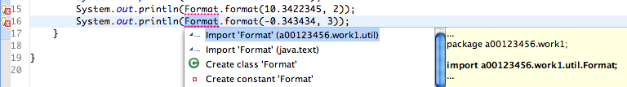
> Using Packages
Problem
Hello doesn’t understand Format
Solution
Click the little icon
Select the first "Import…"
Run Hello
Welcome to COMP 2613
10.34
-0.343

